Slide 1

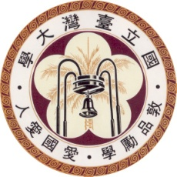
High-speed Sparse Ising Model on FPGA
From: 2019 IEEE 62nd International Midwest Symposium on Circuits and Systems (MWSCAS)
Author: Akira Minamisawa ; Ryoma Iimura ; Takayuki Kawahara
Presenter: Ting-Yi Wu
Instructor: Jie-Hong Roland Jiang
ALCom Lab

Slide 2
Outline
Introduction
Operating principle and sparse speedup of annealing machine
FPGA implementation and verfication
Conclusion

Slide 3
INtroduction

Slide 4
Brief introduction
To implement the Ising model on hardware and create “things” able to process optimization problems for the future Internet of Things (IoT)
Speed up an Ising model and reduce power
Pseudo annealing, Parallel updates and Sparsity of interactions
Implement in a FPGA to solve TSP and SVM

Slide 5
Background
Various “things” have recently become connected to the internet via an internetworking arrangement called the “Internet of Things” (IoT)
The number of combination patterns increases exponentially in accordance with the magnitude of a problem
This study aims to incorporate a method for solving combinatorial optimization problems into “things.”

Slide 6
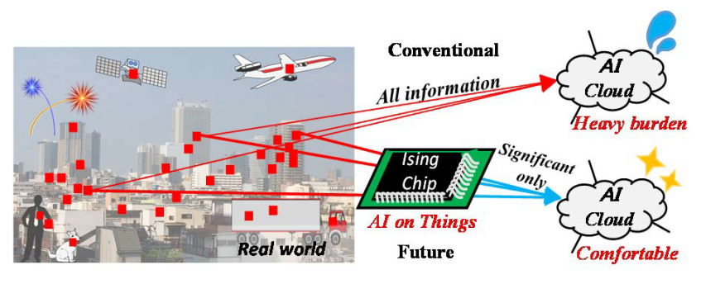
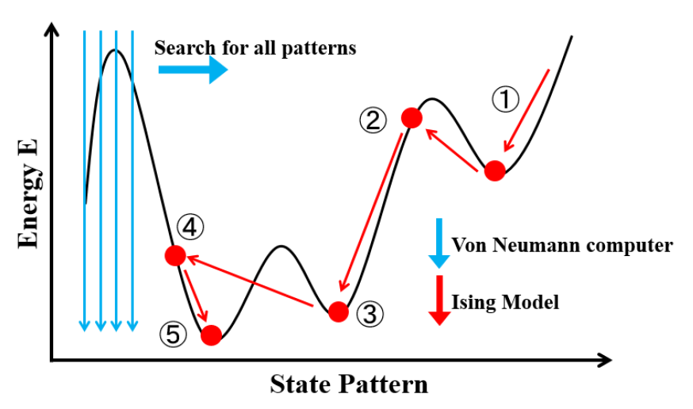
Combinational problem vs Ising model
Ising model has a state transition mechanism that gives a minimum-energy state, which can be treated as an approximate method to the optimization problem [2] if interactions between all spins can be considered.
A combinatorial optimization problem can be obtained as the ground state of the Ising model
To realize a chip that solves the optimization problem, speeding up the Ising model needs to be considered
Speed up -> reduce power -> good for IoT applications

Slide 7
OPERATING PRINCIPLE AND SPARSE SPEEDUP OF ANNEALING MACHINE

Slide 8
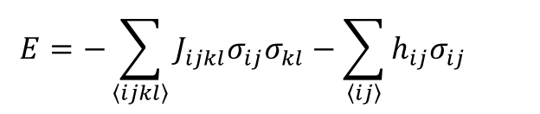
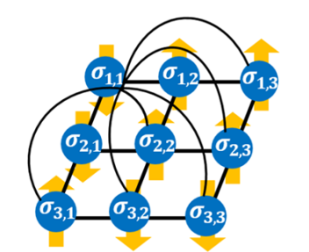
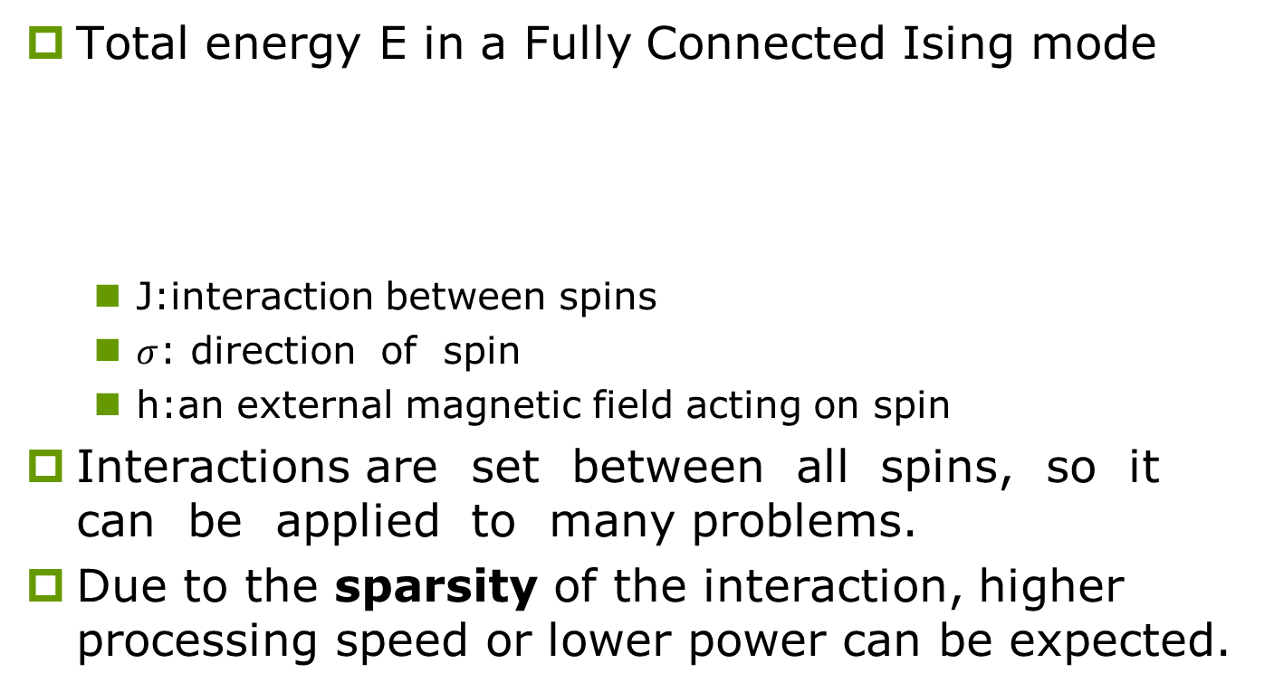
Fully Connected Ising Model
Total energy E in a Fully Connected Ising mode
J:interaction between spins
$σ$: direction of spin
h:an external magnetic field acting on spin
Interactions are set between all spins, so it can be applied to many problems.
Due to the sparsity of the interaction, higher processing speed or lower power can be expected.

Slide 9

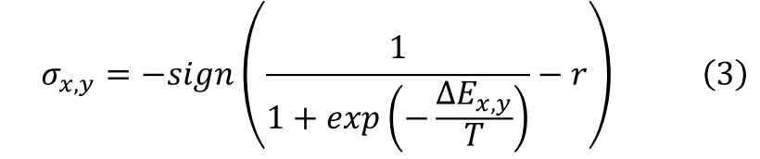
Spin update method
The spins are updated sequentially as the energy decreases and approach the ground state.
slowly
Therefore, D spin updates are implemented in parallel in one step of an update.
The number of update steps is 1 / D, speedup can be expected.
SA is generally used when escape the local minimum
Eq.3 will cause a circuit scale problem. Pseudo-annealing simply performing the SA property while using binary random numbers
High speed and lower power

Slide 10
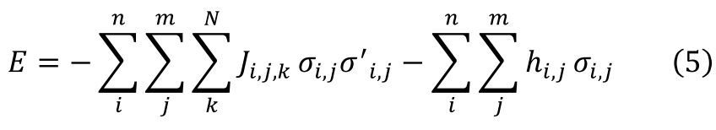
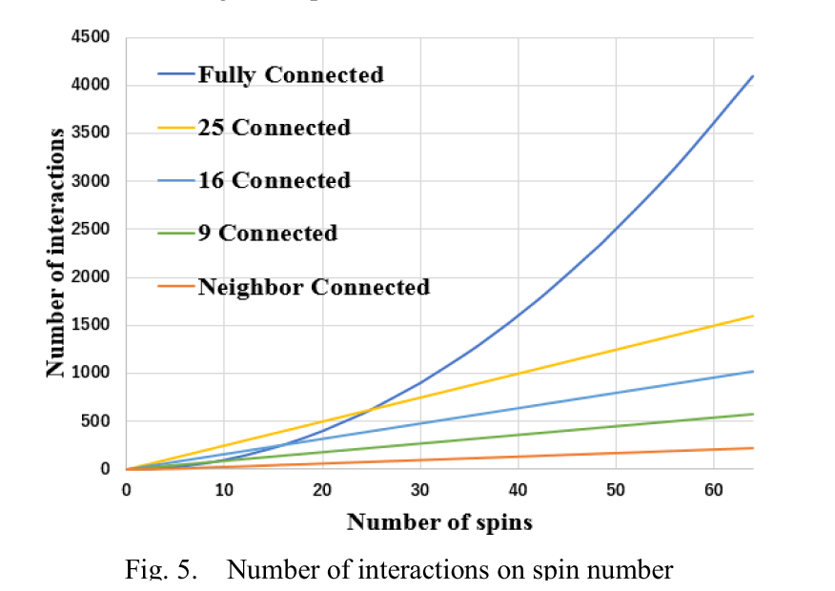
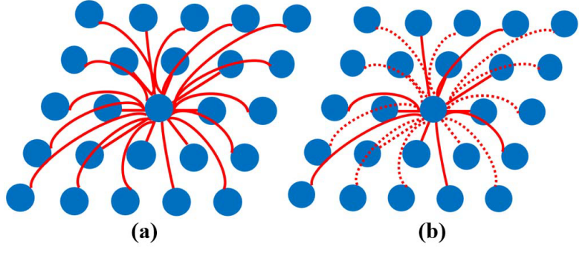
Sparsity of interactions
Sparse interactions exist in the actual fully connected Ising model.
In Fig.(b), the interaction value is often 0
The number of couplings of interactions to a certain spin is limited to N

Slide 11
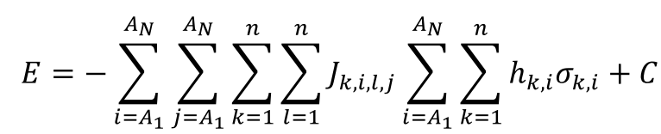
Application to combinatorial optimization problem
The TSP is a typical combinatorial optimization problem that is solved by finding the shortest path that covers a number of cities.
Its objective function of an equivalent Ising model:
Ai : city
k : order
J, h and constant C: determined from the distance between each city.
If upward, Ai
should be visited as the k-th city

Slide 12
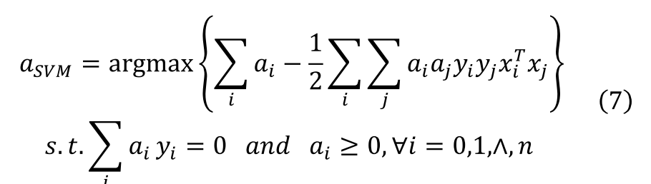

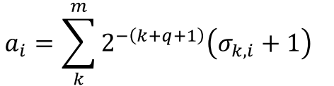
Binary power mapping
Some combinatorial optimization problems take a numerical value of a variable in the range of a real number.
One such problem is an SVM, which maximizes the distance between a recognition boundary and the nearest data from it.
Apply their “binary power mapping” to concert a_{i}

Slide 13
FPGA IMPLEMENTAION AND VERIFICATION

Slide 14
FPGA IMPLEMENTAION AND VERIFICATION
Speed up the 6×6 spin Ising model, a model using pseudo-annealing, parallel updating, and sparse annealing is implemented on the FPGA.
Found the solutions for TSP and SVM
Verify the speed up
Verification environment：
The FPGA (Xilinx Zynq-7000 and ZCU102)
Vivado HLS

Slide 15
Pseudo annealing and parallel update
Using Xilinx Zynq-7000 (ZedBoard) followed by a 16 nm complementary metal-oxide-semiconductor (CMOS) FPGA (Xilinx ZCU102 evaluation board), they implemented each step of updating for SA and pseudo annealing on the FPGA. Also, each model was implemented for parallel updating of 1 to 36 spins, and the solution energy value and the calculation speed were measured.

Slide 16
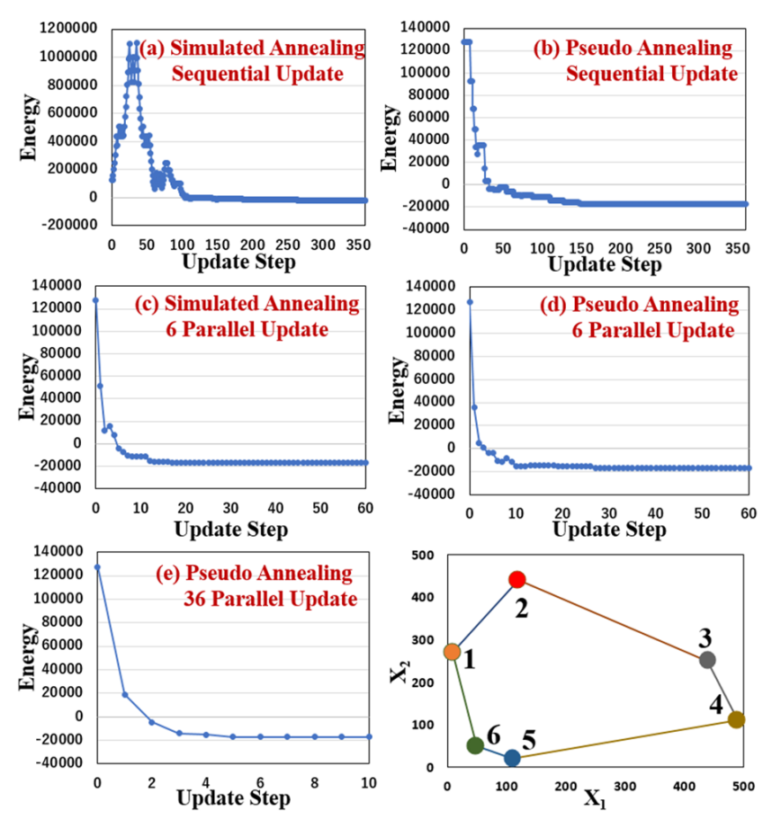
1) TSP

Slide 17
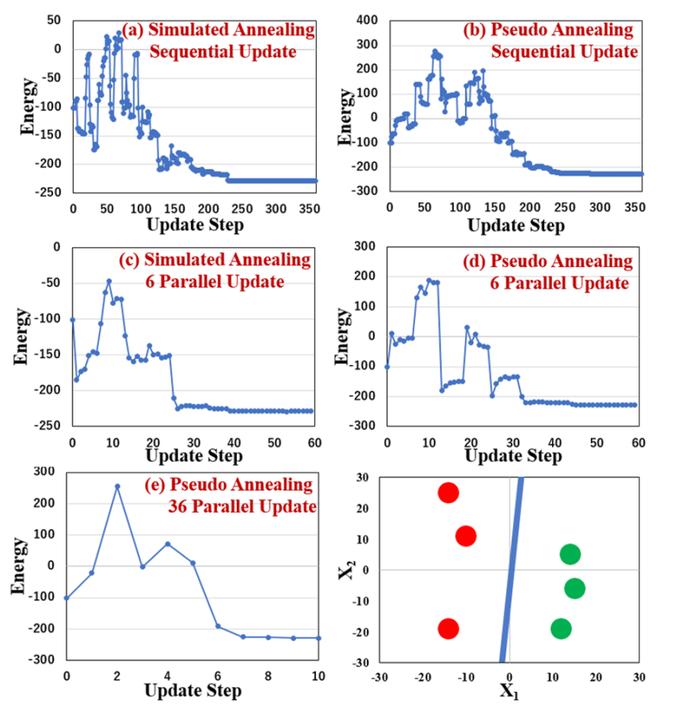
2) SVM

Slide 18
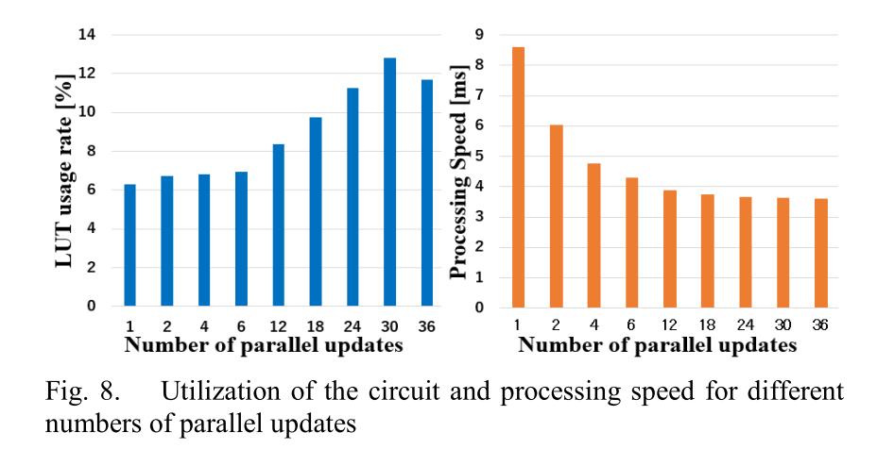
3) Speeding up by parallel update
Using pseudo annealing, each model implemented uses the LUT 30% less on average than SA.
As the number of parallel updates increases, the LUT usage rate and processing speed increase. However, the processing speed stop decreas 18 update. The circuit scale would be large.

Slide 19
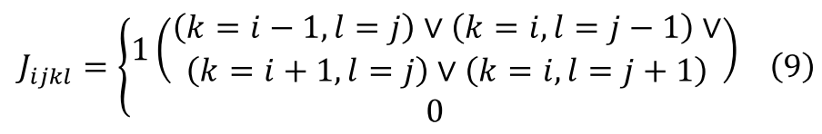
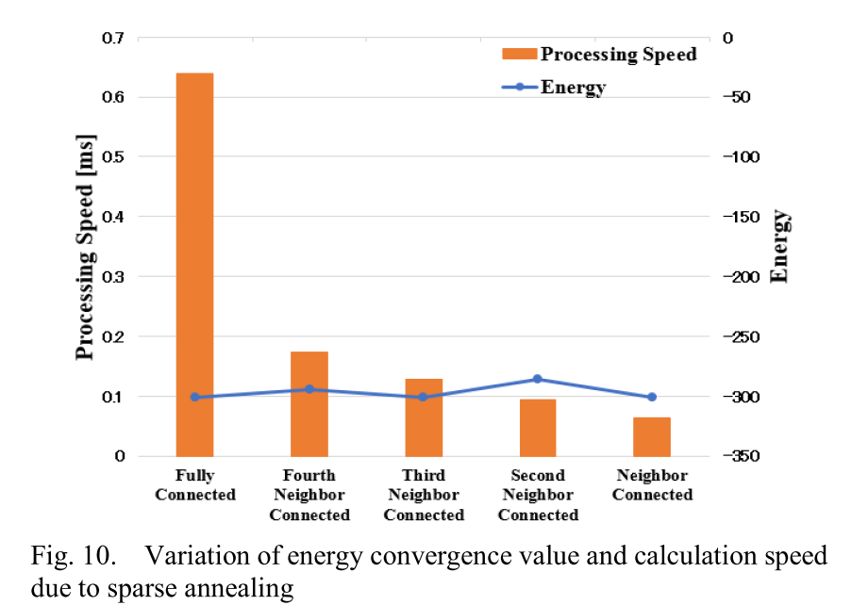
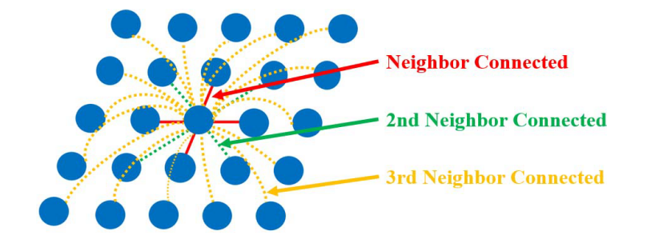
Sparse Ising Model
Noise removal is known as a representative example of the Ising model in which the interaction is sparse. Only the neighbor spins in a given interaction are connected [4][5].
9x

Slide 20
Conclusion
In this paper, to process optimization problems in "things" in the Internet of Things (IoT), an Ising machine was implemented in a 16 nm complementary metal-oxide-semiconductor field-programmable gate array (CMOS FPGA).
Obtain appropriate solutions for two combinatorial problems: the traveling salesman problem (TSP) and support vector machine (SVM).
The Ising model could be sped up and its circuit scale reduced on the FPGA by parallel updating and pseudo annealing
Implemented a sparse annealing machine. From the results of actual measurement with an FPGA, in the case of noise removal, a nearest-neighbor connected Ising model was more than nine times faster than the fully connected Ising model.
By using this Ising model, low power operation can be expected for IoT applications.

Slide 21
Reference
[1] C.M. Bishop, Pattern Recognition and Machine Learning, Springer, (2006).
[2] H. Nishimori, Statistical physics of spin glasses and information processing: an introduction, Clarendon Press, (2001).
[3] S. Utsunomiya, K. Takata, and Y. Yamamoto, "Mapping of Ising models onto injection-locked laser systems," Optics express, 19(19), 18091-18108, doi: 10.1364/OE.19.018091, (2011).
[4] M. Yamaoka, et al. "20k-spin Ising chip for combinational optimization problem with CMOS annealing," IEEE ISSCC Dig. Tech. Papers, pp.432–433, doi: 10.1109/ISSCC.2015.7063111, (2015).
[5] T. Takemoto, et al. " A 2×30k-Spin Multichip Scalable Annealing Processor Based on a Processing-In-Memory Approach for Solving Large-Scale Combinatorial Optimization Problems," IEEE ISSCC Dig. Tech. Papers, pp.52–53, doi: 10.1109/ISSCC.2019.8662517 (2019).
[6] K. Someya, R. Ono, and T. Kawahara, “Novel Ising Model Using Dimension-Control for High-Speed Solver for Ising Machines," Paper ID 4137, Session B2P-F, NEWCAS 2016, doi: 10.1109/NEWCAS.2016.7604797, (2016).
[7] Y. Yoshida, R. Oiwa and T. Kawahara, "Ternary sparse XNOR-Net for FPGA implementation," 2018 7th International Symposium on Next Generation Electronics (ISNE 2018), pp. 1-2. doi: 10.1109/ISNE.2018.8394728, (2018)

Slide 22
THANK YOU

